Slide 1

Work Breakdown Structure

Slide 2
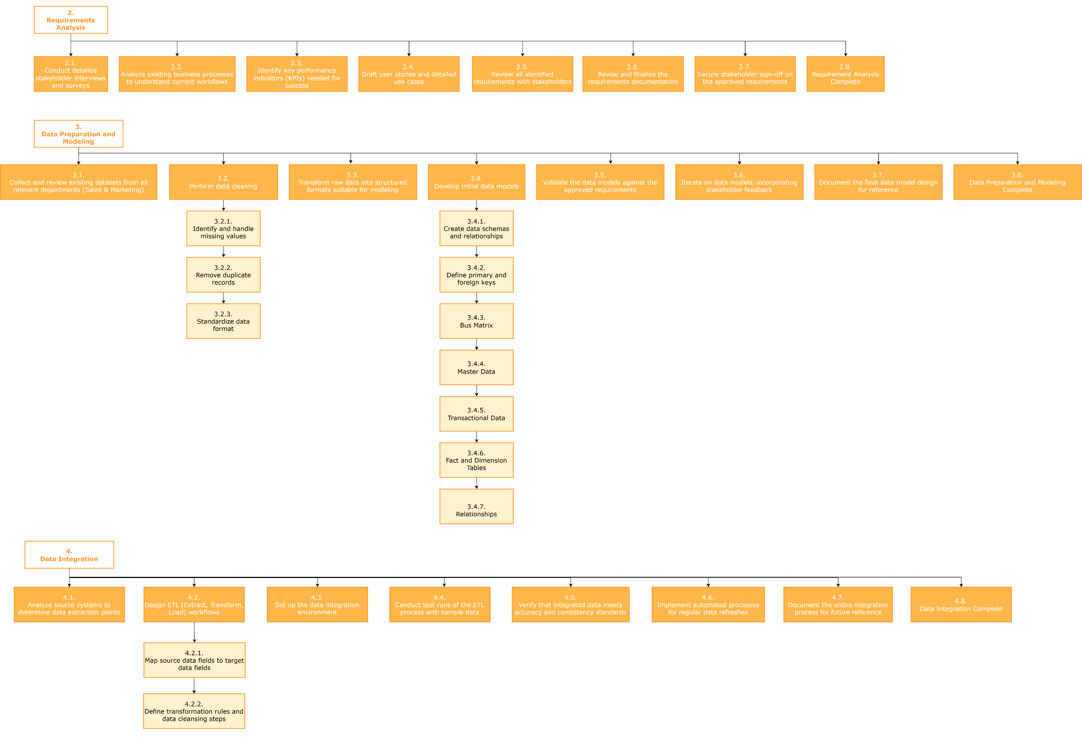

Slide 3
